Slide 1
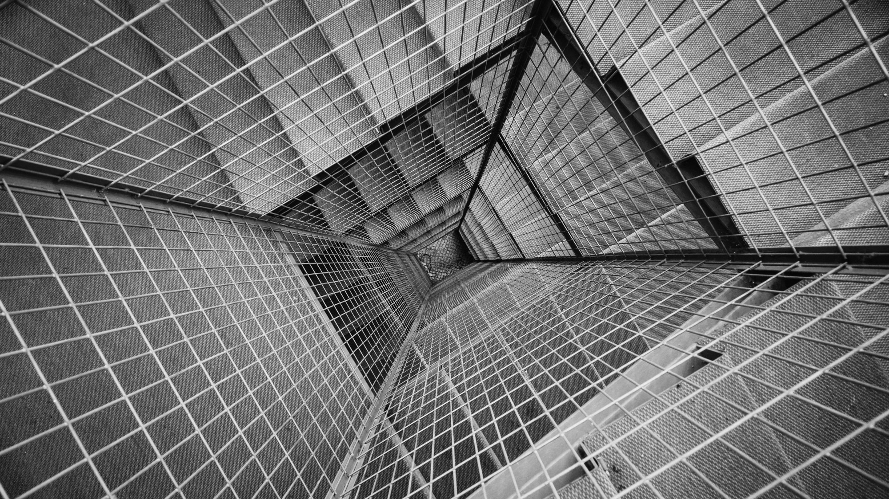
TOTAL TECHNOLOGY
REPORTLAB COMPLETE TUTORIAL
How to draw shapes using graphics package
Tutorial 36

Slide 2
How to generate rectangle shape using graphics
from reportlab.graphics import shapes,renderPDF
from reportlab.lib import colors
drawing_obj=shapes.Drawing(500,200)
drawing_obj.add(shapes.Rect(10,10,250,100,fillColor=colors.blue))
renderPDF.drawToFile(drawing_obj,"tutorial36.pdf",msg="tutorial36")
TOTAL TECHNOLOGY

Slide 3
How to generate circle using graphics package
from reportlab.graphics import shapes,renderPDF
from reportlab.lib import colors
drawing_obj=shapes.Drawing(500,200)
drawing_obj.add(shapes.Circle(50,50,50,fillColor=colors.blue))
renderPDF.drawToFile(drawing_obj,"tutorial36.pdf",msg="tutorial36")
TOTAL TECHNOLOGY

